Slide 1
Lecture-6
Bus Interface

Slide 2
ISA Bus
ISA means Industry Standard Architecture
The main board can accept either an 8-bit ISA card or 16-bit
The ISA card only operates at 8 MHz rate.
the only interfaces found for the ISA bus are modems and sound cards

Slide 3
EISA Local Bus
EISA means Extended Industry Standard Architecture
32 bit modification to the ISA bus
The clocking speed is 8 MHz
Used with disk controller or video graphics adapter

Slide 4
VESA Local Bus
VESA means Video electronics Standards Association
Data bus width is 32-bit
Operates at 33 MHz
Contains a 32-bit address and data bus for interfacing memory or I/O to the μP
Interfaces Video and Disk to the PC

Slide 5
PCI Bus
PCI means Peripheral Component Interconnect
Has Plug and Play characteristics and the ability to function with a 64-bit data bus
Contains a series of registers, located in a small memory device on the PCI interface, that contain information about the board
The information allows the computer to automatically configure the PCI card

Slide 6
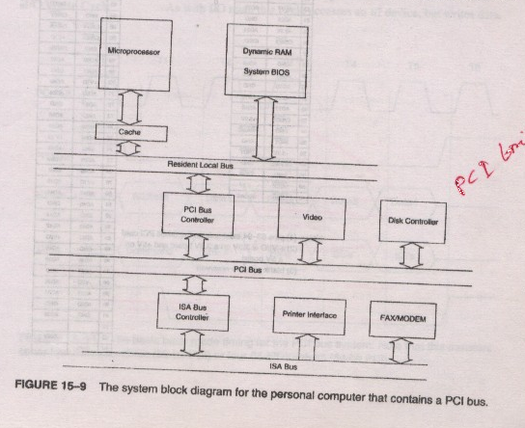
System Structure for PCI Bus

Slide 7

Difference between ISA and PCI bus
ISA | PCI
ISA Stands for Industry Standard Architecture. | PCI Stands for Peripheral Component Interconnect.
It doesn’t have Plug-&-Play Characteristics. | It has Plug-&-Play Characteristics.
ISA functions with 8 or 16 bit data bus. | PCI functions with 64 bit data bus.
The clocking speed is lower than that of PCI. | The clocking speed is greater than that of ISA.
ISA interfaces modems, sound cards etc. | PCI interfaces video controller, disk controller etc.

Slide 8
Universal Serial Bus
It solves the problem created for using ISA sound card
Ideal for keyboards, sound cards, video and modems
Data transfer speeds are 12 Mbps(full-speed operation) and 1.5 Mbps(slow- speed operation )

Slide 9
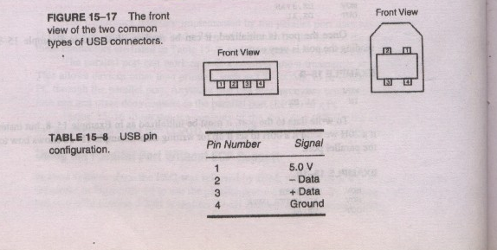
Connector and Pin Configuration

Slide 10

Data Encoding/Decoding
The USB employs NRZI (Non Return to Zero Invert) data encoding when transmitting packets
In NRZI encoding, a 1 is represented by no change in level and a 0 is represented by a change in level. A string of zeros causes the NRZI data to toggle each bit time. A string of ones causes long periods with no transitions in the data.

Slide 11
Bit Stuffing
If a logic 1 is transmitted for more than six bits in a row,the bit stuffing technique adds an extra bit(logic 0) after six continuous 1s in a row.
Ensures that the receiver can maintain synchronization for long strings of 1s

Slide 12
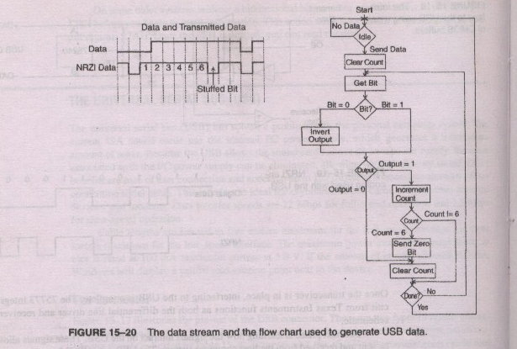
Bit Stuffing

